Slide 1
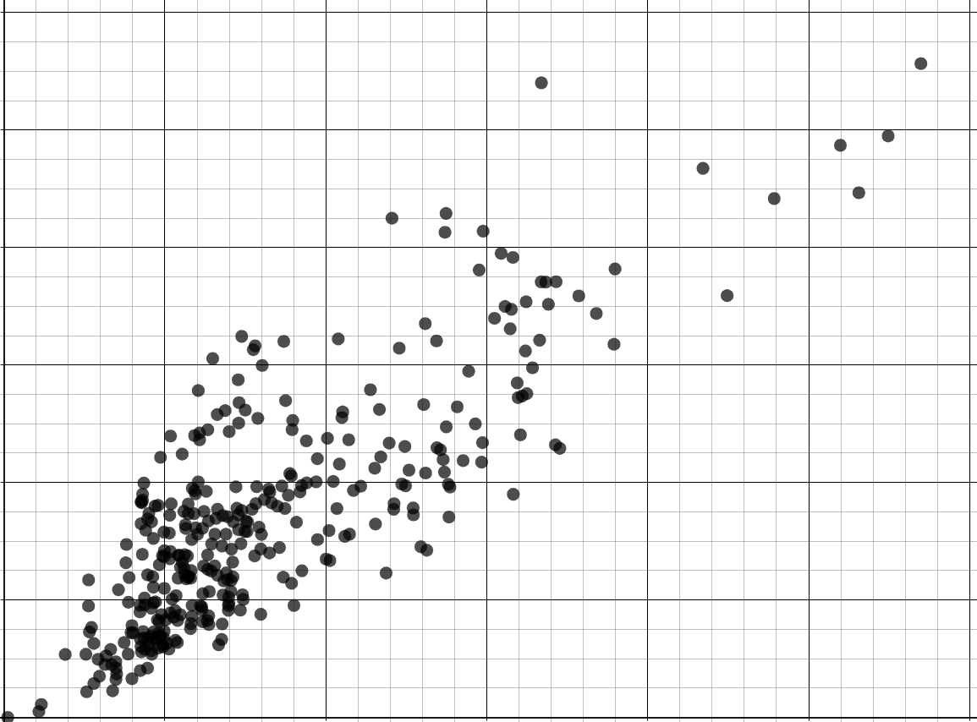
Statistical problems - drawing conclusions
Task A: Drawing conclusions from a statistical investigation
1) A bus company have 98 thousand passengers per day. The table shows the mean number of passengers they have each time of the day.
time | mean number of passengers (thousands)
06:00 - 10:00 | 34.3
10:00 - 14:00 | 19.6
14:00 - 18:00 | 29.4
18:00 - 22:00 | 14.7
a) The bus company wants to encourage more people to travel at unpopular times of the day by offering cheaper tickets. Which time period should tickets be cheaper?
18:00 - 22:00
b) The bus company wants to improve profits by increasing ticket prices at the most popular time of the day. For which time period should prices increase?
06:00 - 10:00
2) A mobile phone provider manages the number of cell towers per town. The table shows the population and the number of cell towers for three towns. The scatter graph shows data from the ONS about other regions across the UK.
town | A | B | C
population (thousands) | 300 | 400 | 60
cell towers (thousands) | 7 | 4 | 6
12
a) In which town should they install more cell towers? Explain why.
10
8
Town B
cell towers (thousands)
4 thousand cell towers is less than most other regions with a similar population.
6
4
b) In which town can they afford to switch off some cell towers? Explain why.
2
Town C
0
6 thousand cell towers is more than most other regions with a similar population.
0
100
200
300
400
500
600
population (thousands)

Slide 2
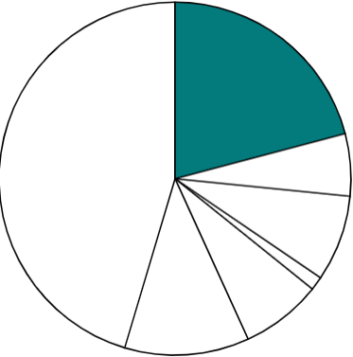



Statistical problems - drawing conclusions
Task B: Acknowledging limitations and problems with conclusions
1) The pie chart shows data (by the ONS) from a survey in 2021 about how people travel to work in the City of London.
If we use this data from London as a sample then we can conclude that around 21% of people in the UK also travel to work by underground rail.
underground rail
21%
train
bus
Alex
walk
taxi
Explain why Alex could be wrong.
cycle
car
The sample only uses data from a single location.
Modes of transport may differ depending on whether they live in a town or city.
Not all towns and cities have an underground rail network.
2) The table shows data from the ONS about the number of property sales each year in Liverpool.
year | properties sold
2018 | 6957
2019 | 6530
2020 | 4524
2021 | 6039
2022 | 5135
mean | 5837
a) Andeep concludes that most cities in the UK must sell around 5837 properties per year. Explain why Andeep could be wrong.
Cities vary in size.
Bigger cities may sell more properties each year.
Smaller cities may sell few properties each year.
b) Laura concludes that Liverpool will always sell around 5837 properties every year. Explain why Laura could be wrong.
The number of property sales might change in the future (e.g. if the population increases or more houses are built).
2020 had an unusually low number of sales.
Mathematics in Education and Industry
v2.2

